Slide 1
Giga wireless communication via MQTT
By: Harman Singh

Slide 2
What is MQTT?
Message Queuing Telemetry Transport is simply a network protocol
Uses publish-subscribe method for message communication/queuing

Slide 3




Basic MQTT Architecture
An MQTT broker (we’ll be using HiveMQ for this project)
RHIT-OPEN (or any other Wi-Fi)
RHIT-OPEN (or any other Wi-Fi)
*The GIGA and your laptop do not have to be connected to the same Wi-Fi
Your laptop
Arduino GIGA

Slide 4
How it works
Publishing to topic “x” – sending data to topic “x” and their subscribers
Subscribing to topic “x” – receiving data from things publishing to topic “x”
The broker acts as a middle man of handling and sending publish/subscribe topics
Example:
Arduino publishes to topic “ultrasonic-data”
MATLAB subscribes to “ultrasonic-data”
Any time the Arduino publishes data to “ultrasonic-data” MATLAB will automatically receive that data
Warning: since we are using a public broker that can be accessed by anyone, it is IMPORTANT to have UNIQUE topic names so you don’t accidentally send/receive data from other topics. A good convention is to use the following structure >> Arduino would publish to “ece425/your_username/to_matlab”, and matlab would subscribe to the same topic

Slide 5
Visual example - setup
Arduino publishes to “ece425/user/sonar”
Computer subscribes to “ece425/user/sonar”
An MQTT broker (we’ll be using HiveMQ for this project)
RHIT-OPEN (or any other Wi-Fi), RHIT-OPEN Recommended
RHIT-OPEN (or any other Wi-Fi), RHIT-OPEN Recommended
*A single device (Arduino/computer) can be subscribed/publish to multiple topics!
Your laptop
Arduino GIGA

Slide 6
Visual example – real time communication
Arduino sends data to “ece425/user/sonar”
Computer receives data from “ece425/user/sonar”
An MQTT broker (we’ll be using HiveMQ for this project)
RHIT-OPEN (or any other Wi-Fi)
RHIT-OPEN (or any other Wi-Fi)
Your laptop
Arduino GIGA

Slide 7
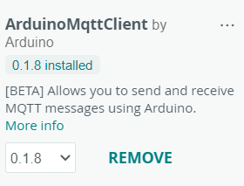
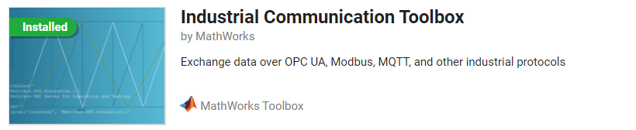
Code walkthrough - SETUP
Arduino – install the ArduinoMQTTClient Library
MATLAB – Install the “Industrial Communication Toolbox”

Slide 8
Code walkthrough - arduino
The sample code provided should be pretty self explanatory with the inline comments and serial print statements provided. The code should run as is and work. You must install the ArduinoMQTT Client library
IMPORTANT: When you are done getting everything to work and it all checks out, remove all serial-related statements (like Serial.println ) when you want it to work when the USB cable is unplugged from the arduino. If there are serial commands occurring when the serial cable is not connected to the computer, your code will not work because it will continuously send serial commands until it knows the computer received it

Slide 9
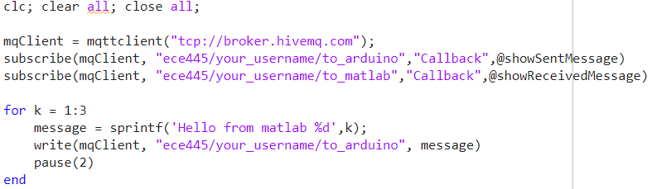
Code walkthrough - matlab
The MATLAB “Industrial Communication Toolbox” package must be installed to support MQTT communication
Subscribe to topics, and attach callbacks (or functions) that get called when messages are sent/received. Function descriptions are on next slide
Method to publish to topics

Slide 10
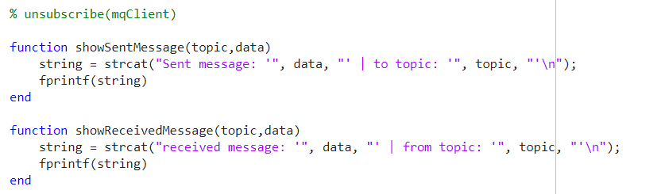
Code walkthrough - matlab
It is good practice to unsubscribe/close the MQTT client when you’re done using it

